Slide 1
Replication and Reproducibility in Social Sciences and Statistics: Context, Concerns, and Concrete Measures when Data are Confidential
Lars Vilhuber
Cornell University
Partial funding acknowledged under NSF-#1131848 (NCRN) and a grant from the Alfred P. Sloan Foundation. The opinions expressed in this talk are solely the authors, and do not represent the views of the U.S. Census Bureau, the American Economic Association, or any of the funding agencies.
Notes:
I am going to
Very briefly describe the background we are coming from
Make note of the various elements of progress (and the broader picture) of open science
Describe some of the ongoing challenges
Provide a glimpse of what is going to happen in economics, and maybe more broadly in the social sciences.

Slide 2
Disclaimer
My opinions
Not Census Bureau
Not American Economic Association
No confidential data was abused in this talk

Slide 3
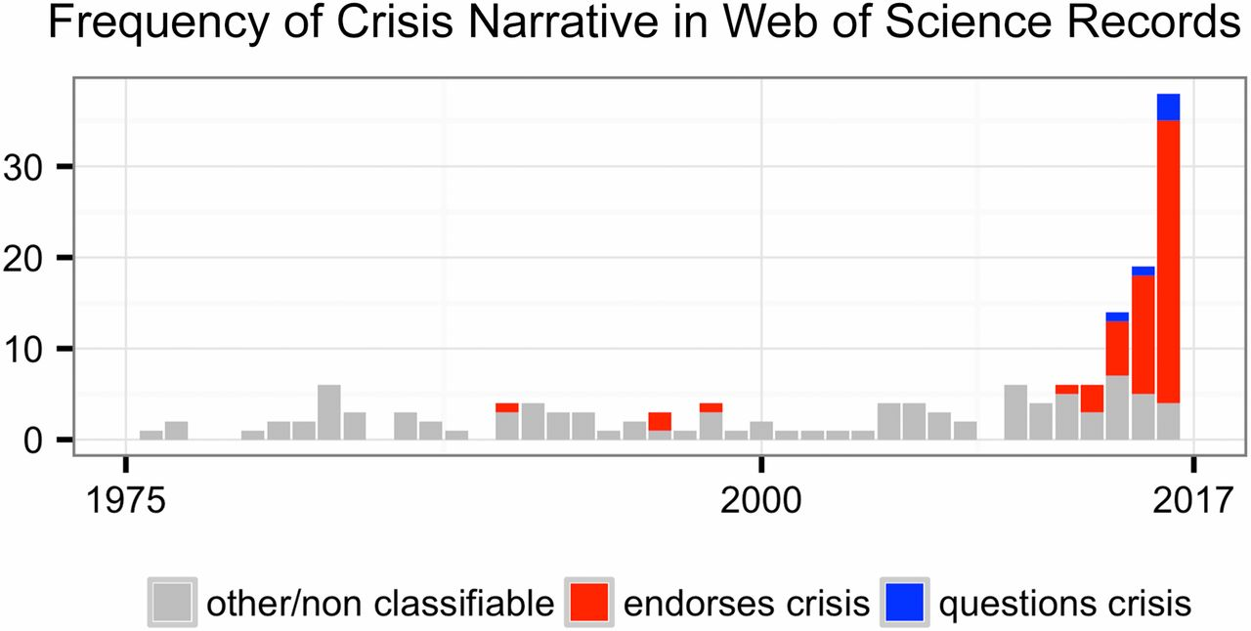
This reproducibility crisis thing….
https://doi.org/10.1073/pnas.1708272114
Notes:
Number of Web of Science records that in the title, abstract, or keywords contain one of the following phrases: “reproducibility crisis,” “scientific crisis,” “science in crisis,” “crisis in science,” “replication crisis,” “replicability crisis.” Records were classified by the author according to whether, based on title and abstracts, they implicitly or explicitly endorsed the crisis narrative described in the text (red), or alternatively questioned the existence of such a crisis (blue), or discussed “scientific crises” of other kinds or could not be classified due to insufficient information (gray).

Slide 4
The “crisis” in the 60s and 70s Sterling, 1959; Cohen, 1962; Lykken, 1968; Tukey, 1969; Greenwald, 1975; Meehl, 1978; Rosenthal, 1979
Low power
Flexibility in analysis
Selective reporting
Ignoring nulls
Lack of replication
Misuse of statistics
Source: Nosek Sackler talk 2017
Notes:
Source: Nosek, NAS.Sackler.2017.03.10
Examples from:
Button et al – Neuroscience
Ioannidis – why most results are false (Medicine)
GWAS
Biology
Two possibilities are that the percentage of positive results is inflated because negative results are much less likely to be published, and that we are pursuing our analysis freedoms to produce positive results that are not really there. These would lead to an inflation of false-positive results in the published literature.
Some evidence from bio-medical research suggests that this is occurring. Two different industrial laboratories attempted to replicate 40 or 50 basic science studies that showed positive evidence for markers for new cancer treatments or other issues in medicine. They did not select at random. Instead, they picked studies considered landmark findings. The success rates for replication were about 25% in one study and about 10% in the other. Further, some of the findings they could not replicate had spurred large literatures of hundreds of articles following up on the finding and its implications, but never having tested whether the evidence for the original finding was solid. This is a massive waste of resources.
Across the sciences, evidence like this has spurred lots of discussion and proposed actions to improve research efficiency and avoid the massive waste of resources linked to erroneous results getting in and staying in the literature, and about the culture of scientific practices that is rewarding publishing, perhaps at the expense of knowledge building. There have been a variety of suggestions for what to do. For example, the Nature article on the right suggests that publishing standards should be increased for basic science research.
[It is not in my interest to replicate – myself or others – to evaluate validity and improve precision in effect estimates (redundant). Replication is worth next to zero (Makel data on published replications; motivated to not call it replication; novelty is supreme – zero “error checking”; not in my interest to check my work, and not in your interest to check my work (let’s just each do our own thing and get rewarded for that)
Irreproducible results will get in and stay in the literature (examples from bio-med). Prinz and Begley articles (make sure to summarize accurately)
The Nature article by folks in bio-medicine is great. The solution they offer is a popular one in commentators from the other sciences -- raise publishing standards.

Slide 5
Efficiency of scholary discourse?
Early publications (20th century) contained tables of data, and the math was simple (maybe)
Data became electronic, was no longer included or cited
Math was transcribed to code, and was no longer included

Slide 6
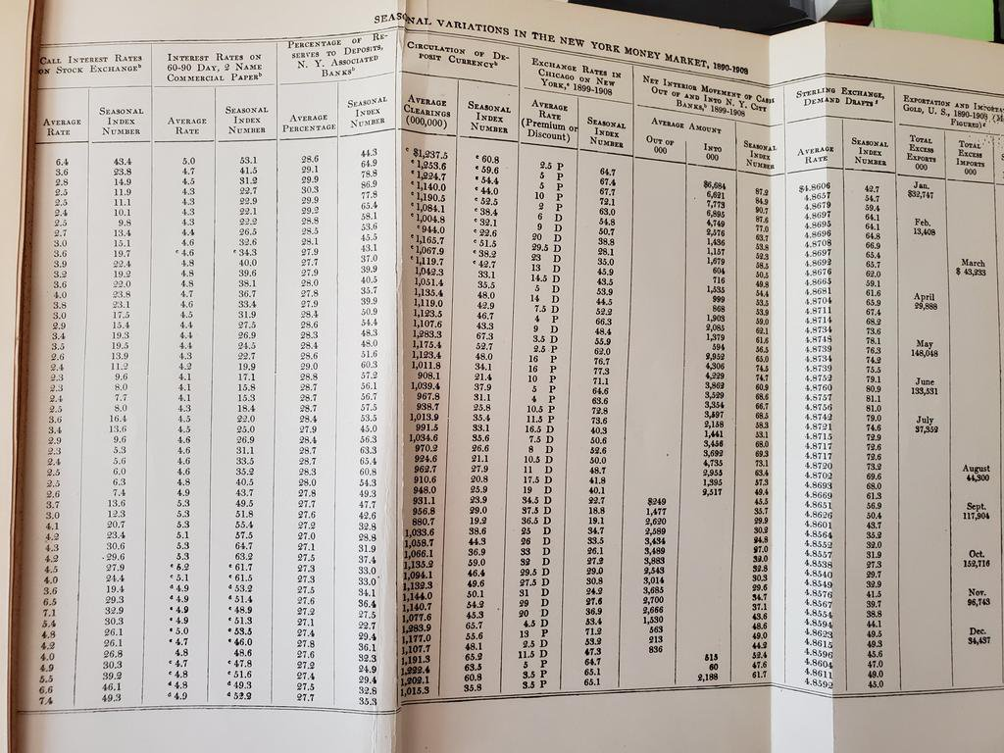
From @sdellavi
AER 1911

Slide 7
Efficiency of scholary discourse!
Modern publications thus need the same transparency and completeness as in the old days
to facilitate replicability

Slide 8
Replication?

Slide 9
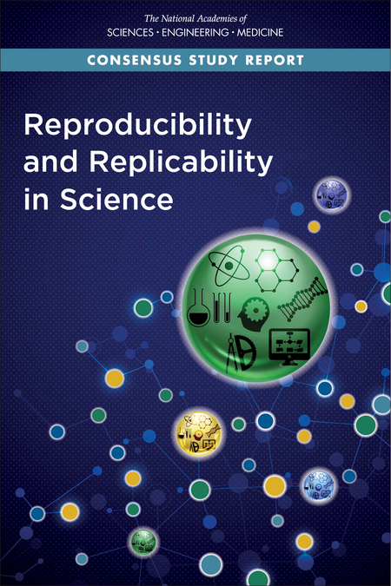
Replication continuum
https://doi.org/10.17226/25303
08
Reproducibility
Narrow Replication (Pesaran 2003)
Pure Replication (Hamermesh 2007)
Verification (Clemens 2015)

Slide 10
Replication continuum
Same data | Same code | Same methods | Same context
08
Reproducibility
Narrow Replication (Pesaran 2003)
Pure Replication (Hamermesh 2007)
Verification (Clemens 2015)

Slide 11
Replication continuum
08
08
Reproducibility
Replicability
Narrow Replication (Pesaran 2003)
Pure Replication (Hamermesh 2007)
Verification (Clemens 2015)
Wide Replication (Pesaran 2003)
Statistical Replication (Hamermesh 2007)
Reproduction/Reanalysis (Clemens 2015)

Slide 12
Replication continuum
Same data | Different code | Same methods | Same context
 | or software
08
08
Reproducibility
Replicability
Narrow Replication (Pesaran 2003)
Pure Replication (Hamermesh 2007)
Verification (Clemens 2015)
Wide Replication (Pesaran 2003)
Statistical Replication (Hamermesh 2007)
Reproduction/Reanalysis (Clemens 2015)

Slide 13
Replication continuum
New data | Same code | Same methods | Same context
collection
08
08
Reproducibility
Replicability
Narrow Replication (Pesaran 2003)
Pure Replication (Hamermesh 2007)
Verification (Clemens 2015)
Wide Replication (Pesaran 2003)
Statistical Replication (Hamermesh 2007)
Reproduction/Reanalysis (Clemens 2015)

Slide 14
Replication continuum
08
08
08
Reproducibility
Replicability
Generalizability
Narrow Replication (Pesaran 2003)
Pure Replication (Hamermesh 2007)
Verification (Clemens 2015)
Wide Replication (Pesaran 2003)
Statistical Replication (Hamermesh 2007)
Reproduction/Reanalysis (Clemens 2015)
Wider Replication (Pesaran 2003)
Scientific Replication (Hamermesh 2007)
Reanalysis/Robustness (Clemens 2015)

Slide 15
Replication continuum
Different data | Different code | Different | Different
 | or software | methods | context or
 |  |  | country
08
08
08
Reproducibility
Replicability
Generalizability
Narrow Replication (Pesaran 2003)
Pure Replication (Hamermesh 2007)
Verification (Clemens 2015)
Wide Replication (Pesaran 2003)
Statistical Replication (Hamermesh 2007)
Reproduction/Reanalysis (Clemens 2015)
Wider Replication (Pesaran 2003)
Scientific Replication (Hamermesh 2007)
Reanalysis/Robustness (Clemens 2015)

Slide 16
Progress

Slide 17
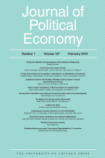
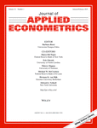


Progress
Replication archives and Data (Code) Availability policies

Slide 18
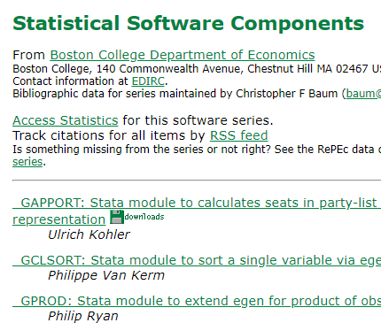

Progress
Replication archives and Data (Code) Availability policies
Shared open source software

Slide 19

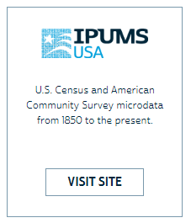




Progress
Replication archives and Data (Code) Availability policies
Shared open source software
Better public-use and shared data

Slide 20


Progress
Replication archives and Data (Code) Availability policies
Shared open source software
Better public-use and shared data
Better ways of accessing preprints/ grey literature

Slide 21



Progress
Replication archives and Data (Code) Availability policies
Shared open source software
Better public-use and shared data
Better ways of accessing preprints/ grey literature
Pre-registration of trials, experiments, and analyses

Slide 22
More recently…

Slide 23
Second round (2012-)
Greater enforcement of data (and code) availability
2015, AJ Political Science
2016, Data Editor for ASA Software Section
2016, Statistical review added Science
2017: AEA appoints Data Editor, with mandate to do similar activities (also EJ, Restud)

Slide 24
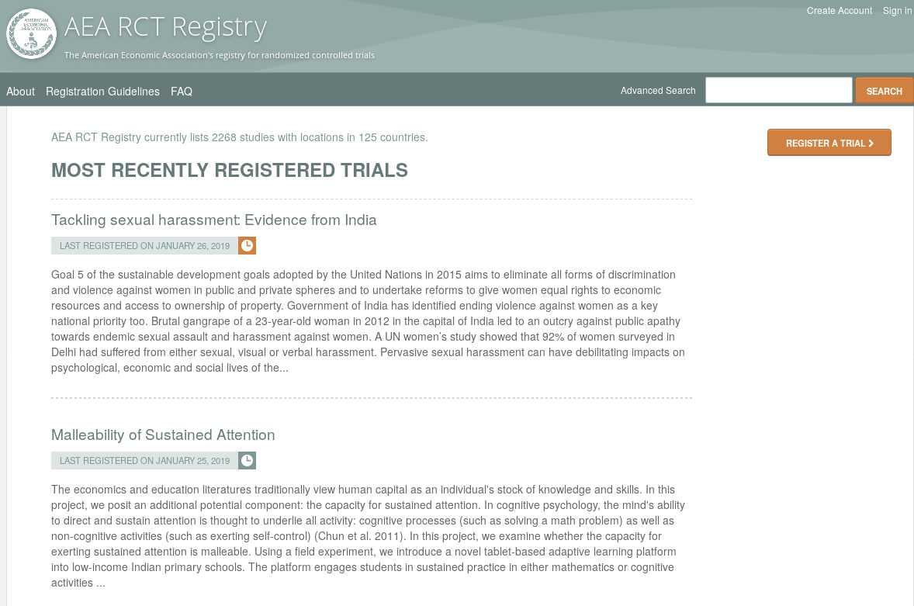
Pre-registration
“That information is especially helpful in research that emphasizes null hypothesis significance testing.
A thorough preregistration promotes transparency and openness and protects researchers from suspicions of p-hacking.”
https://www.psychologicalscience.org/publications/psychological_science/preregistration

Slide 25

Registered Reports
https://cos.io/rr
Chambers (2014)
Nosek & Lakens (2014)
Close cousin: Results-blind review

Slide 26


Preprints in other sciences
bioRxiv (2013)
PsyArXiv (2016)

Slide 27
Paluck (2018) https://osf.io/kvbnh/

Slide 28
Restricted-Access Data Pose Problems

Slide 29
Challenges
Documentation
How can others learn about the data?
Verifiability
How can others obtain access?
Persistence
How are data and programs preserved?

Slide 30
Challenges
Documentation
How can others learn about the data?
Verifiability
How can others obtain access?
Persistence
How are data and programs preserved?
Documentation
How can others learn about the data?

Slide 31
Lack of proper dataset citation or identification

Slide 32
Economics makes wide use of public-use data
Macrodata:
“We use data downloaded from the Bureau of Economic Analysis…”
Microdata:
“… this paper uses data from the Current Population Survey…”

Slide 33
Relevant example
Page 5 of Online Appendix:
The manuscript, the online appendix, and the README contain no reference to the data location or the fact that the U.S. Census Bureau publishes the Business Dynamics Statistics.
Sedláček & Sterk (2017) 10.1257/aer.20141280

Slide 34
This should be easy!

Slide 35
Problems Making RELIABLE archives
Many datasets
Are imperfectly described
Very few data citations
Are badly documented
Have no (permanent) location defined
Even for data from high-profile organizations!
All of the above

Slide 36
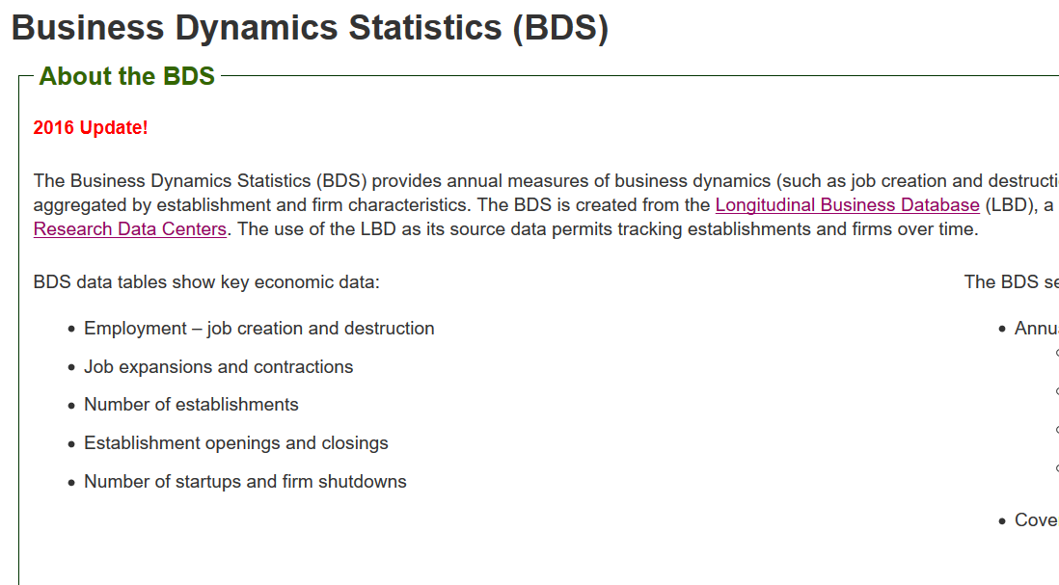
Example: BDS
No DOI or permanent URL
No suggested data citation
No versioned data releases
Doesn’t make it easy!

Slide 37
<sidenote>

Slide 38
What is a data citation?
Benefits for data producers:
provides proper attribution and credit
creates a bibliographic "trail", connecting publications and supporting data
demonstrates the impact of their work and establishes research data as an important contribution to the scholarly record
Benefits for data users:
citation makes it easier to find datasets
supports persistence of datasets
encourages the reuse of data for new research questions
https://data.research.cornell.edu/content/data-citation

Slide 39
What is a data citation?
Benefits for everyone:
increases transparency and reproducibility
https://data.research.cornell.edu/content/data-citation

Slide 40
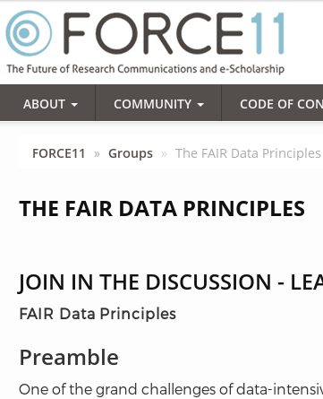
Action: Data citations and metadata
What is FAIR?
Findable,
Accessible,
Interoperable, and
Re-usable

Slide 41
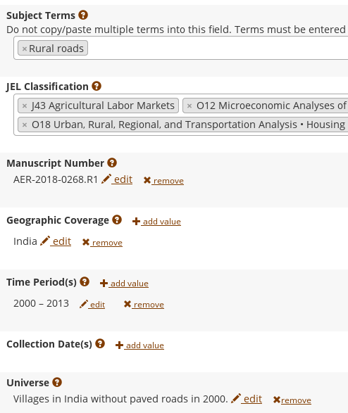
FAIR principles rely on metadata

Slide 42
</sidenote>

Slide 43
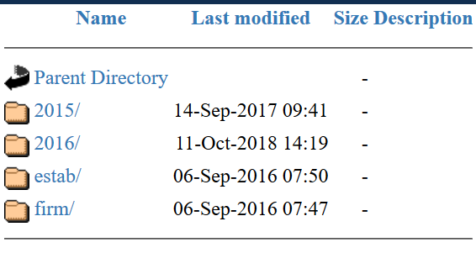
Example: BDS
Note on versioned releases
Recent releases are for “additional years of coverage” (2016 = data for 2016)
Does not account for the possibility of re-releases or corrections of data

Slide 44
Especially problematic for confidential data

Slide 45
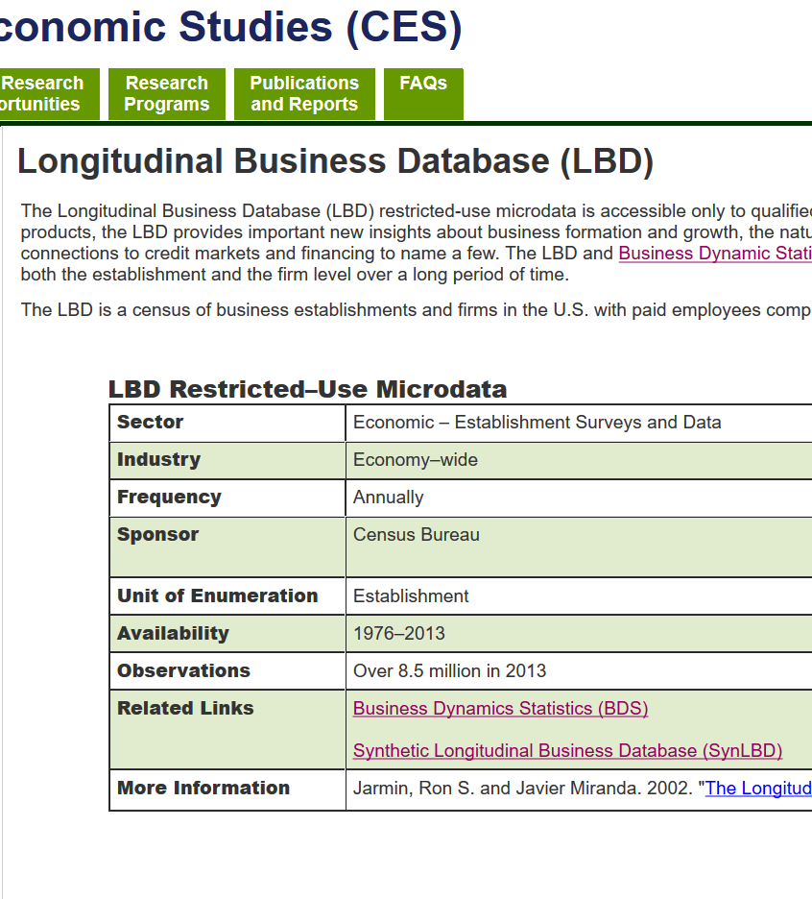
Example: LBD
No DOI
No suggested data citation
No public summary statistics
No public codebook

Slide 46
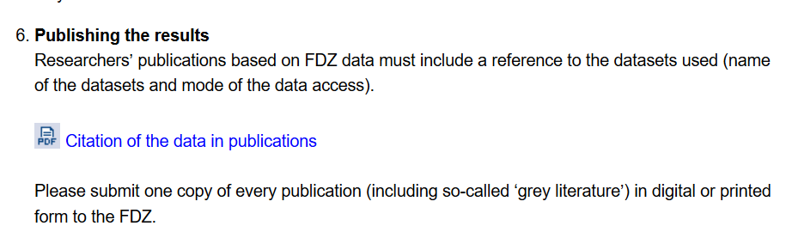
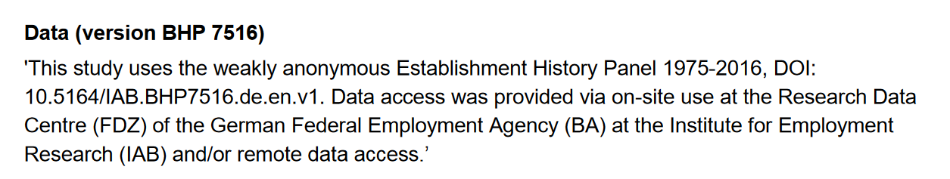
It can be done

Slide 47
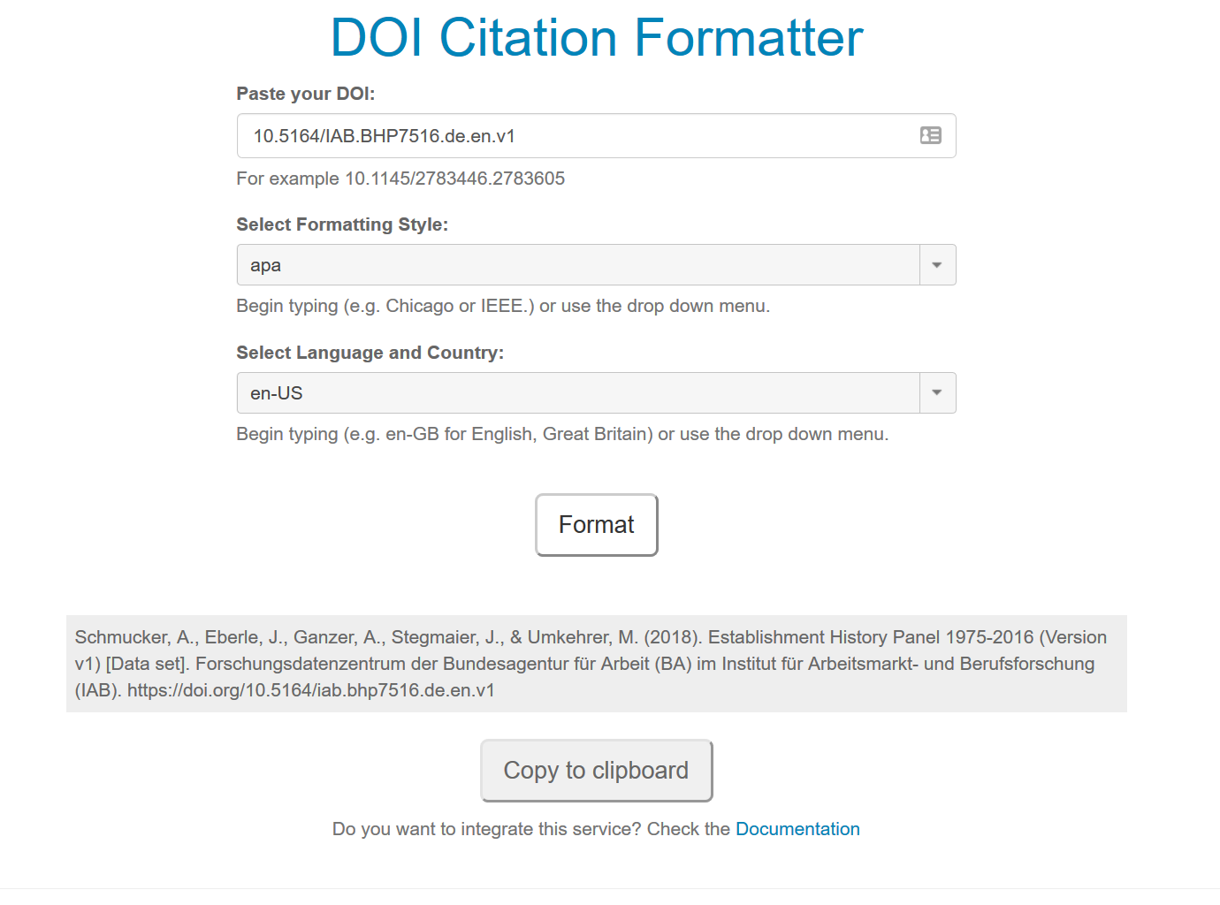
Formatted citation

Slide 48
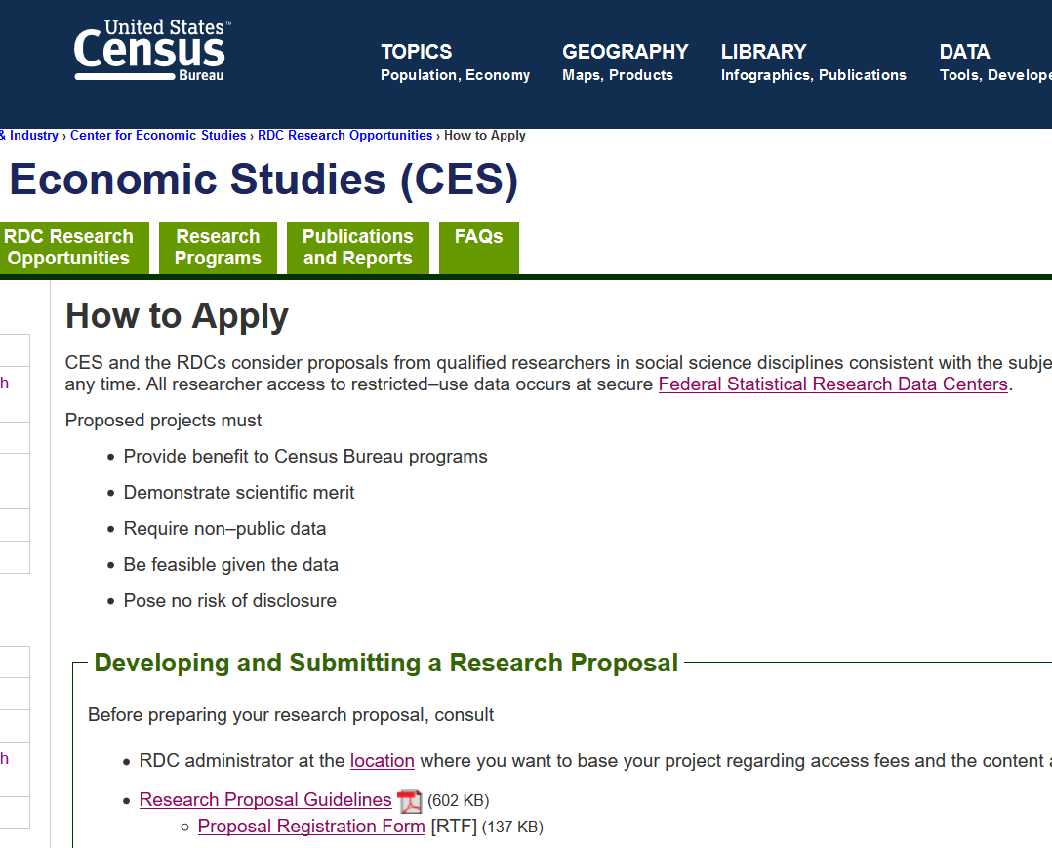
Documenting access
Just as important as describing what data you used: how can others access the data?
May be the same way you accessed the data
May differ, have changed
How to keep up to date?
Link to the agency page (“Application portal”)!

Slide 49
Documenting access
“The Longitudinal Business Database can be accessed by authorized users through the Federal Statistical Research Data Centers. For more information, see https://www.census.gov/ces/rdcresearch/howtoapply.html

Slide 50
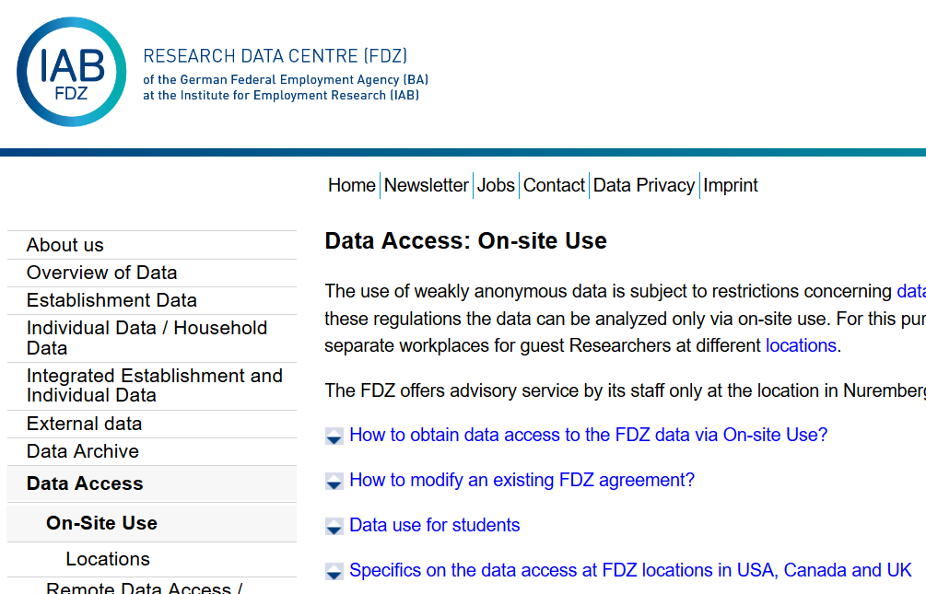
Documentating access
“Data can be accessed via on-site use at the Research Data Centre (FDZ) of the German Federal Employment Agency (BA) at the Institute for Employment Research (IAB. For more information and requirements, see https://fdz.iab.de/en/FDZ_Data_Access/FDZ_On-Site_Use.aspx

Slide 51
How to improve?
Agencies should provide template language for researchers to use
Agencies should provide data citations (see IAB example)
Agencies should provide DOI
Agencies should provide public documentation
Database schema/ structure/ codebook
Generic summary statistics

Slide 52
Challenges
Documentation
How can others learn about the data?
Verifiability
How can others obtain access?
Persistence
How are data and programs preserved?
Verifiability
How can others obtain access?

Slide 53
Reproducibility problems
Is it reproducible in the first place?
How can I prove it to others?

Slide 54
Not enough articles are reproducible

Slide 55
Replication continuum
Same data | Same code | Same methods | Same context
08
08
08
Reproducibility
Replicability
Generalizability
Narrow Replication (Pesaran 2003)
Pure Replication (Hamermesh 2007)
Verification (Clemens 2015)
Wide Replication (Pesaran 2003)
Statistical Replication (Hamermesh 2007)
Reproduction/Reanalysis (Clemens 2015)
Wider Replication (Pesaran 2003)
Scientific Replication (Hamermesh 2007)
Reanalysis/Robustness (Clemens 2015)

Slide 56
Results?

Slide 57
Some key statistics
Study | Year | N | Success | Type | Type-R | Type-Data | Percent | Field
Dewald Thursby Anderson | 1986 | 54 | 2 | Complete | Reproducibility | Avail | 4% | Economics
Dewald Thursby Anderson | 1986 | 54 | 7 | Partial | Reproducibility | Avail | 13% | Economics
McCullough McGeary Harrison | 2006 | 186 | 14 | Complete | Reproducibility | All | 8% | Economics
McCullough McGeary Harrison | 2006 | 62 | 14 | Complete | Reproducibility | Avail | 23% | Economics
Nosek et al | 2015 | 100 | 36 | Complete | Replication |  | 36% | Psychology
Camerer et al | 2016 | 18 | 11 | Complete | Replication |  | 61% | Experimental Econ
Chang Li | 2017 | 67 | 22 | Complete | Reproducibility | Avail | 33% | Macroeconomics
Kingi et al | 2018 | 274 | 69 | Complete | Reproducibility | All | 25% | Economics
Kingi et al | 2018 | 162 | 69 | Complete | Reproducibility | Avail | 43% | Economics
Kingi et al | 2018 | 162 | 137 | Partial | Reproducibility | Avail | 85% | Economics
Kingi et al numbers are preliminary. Do not cite or quote.

Slide 58

In a nutshell
40% use restricted-access data
25% use public-use data and are mostly or completely reproducible
25% use public-use data and are only partially reproducible
10% fail to yield useful results
It’s only ½ full!
Hey, it’s not empty!

Slide 59
Reproducibility is harder than it should be
Often done piecemeal
At different times
By different people
Software versions
Stata 9? 15? 42?
rdrobust 2014? 2016? 2018 bug fix?
Compilers and exotic software

Slide 60
Most frequent problem

Slide 61
Making USEFUL archives
From analysis of code from 1996 to 2003 (MMH2006):
“Other authors seem to think that the entire world shares the exact same hard drive layout, with ‘‘C:\MYDATA\MYPROJECT\” sprinkled liberally throughout their code. Of course, a would-be replicator has to find and change all these.”
“The author might not realize all the data/subroutine files that his code utilizes, and forget to include said data/subroutine in his replication files.”

Slide 62
Especially true in FSRDC…

Slide 63
Issues in RDCs
Changes in file locations and directory
Changes in computing architecture
Not specific to RDCs:
Change in RA team
Data flow management
Broken dependencies

Slide 64
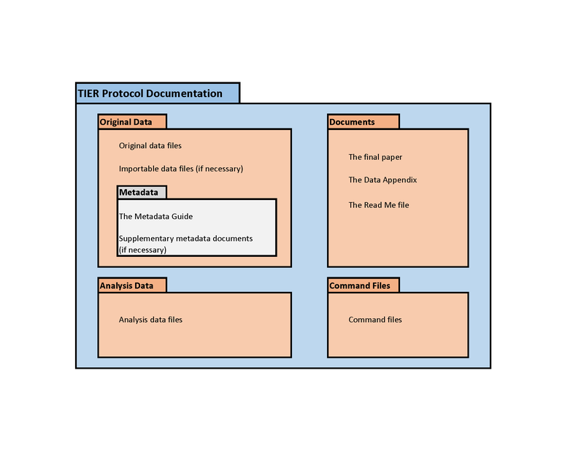
Use best practices for reproducibility
TIER Protocol
Versioning of code (and data!)
Robust programming techniques (configuration files, modular code)
Secure programming techniques! (no confidential parameters in core code)

Slide 65
How can others verify reproducibility?

Slide 66
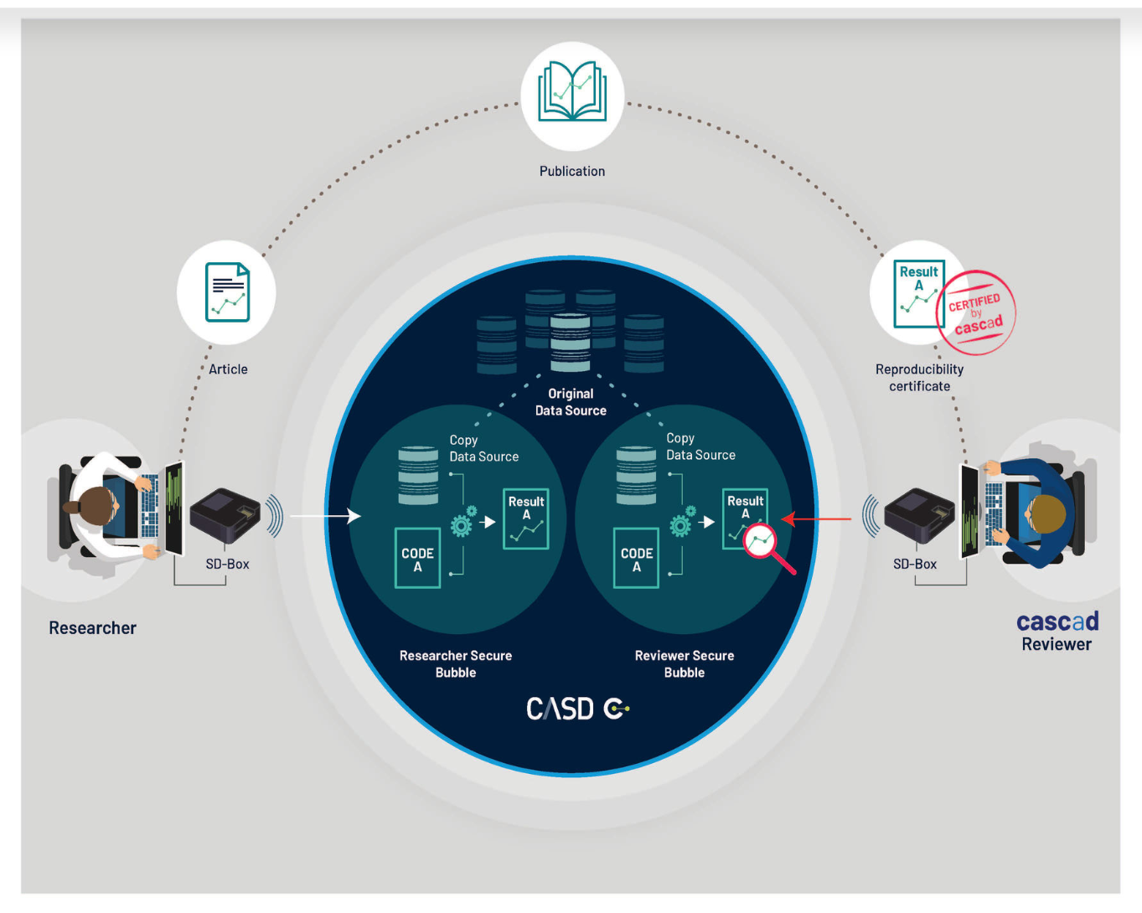
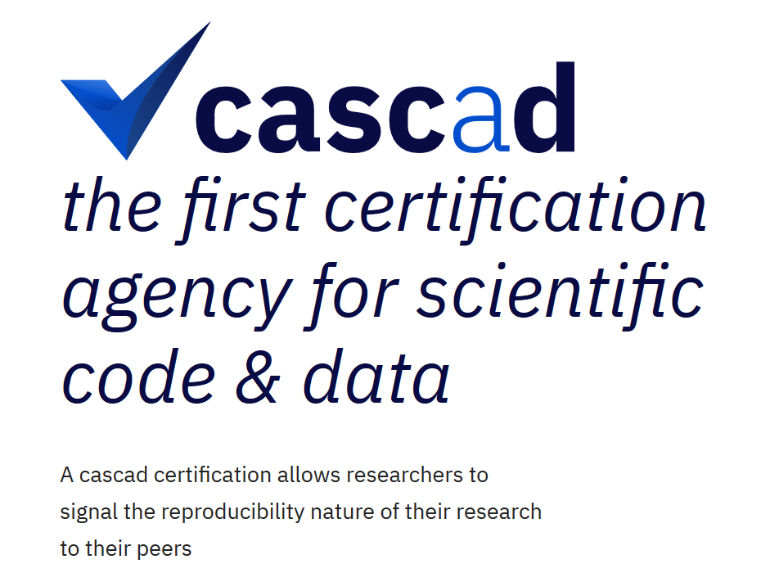
How can others verify reproducibility?

Slide 67
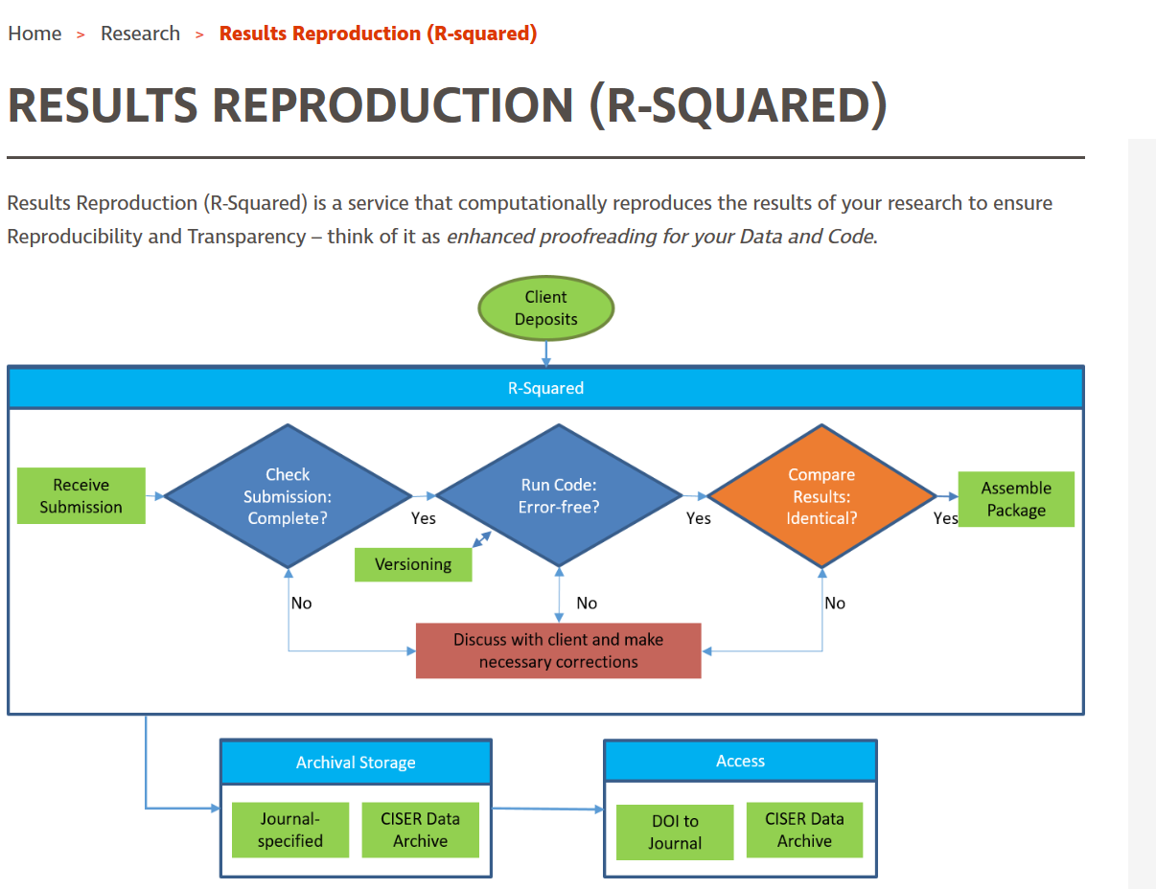



Verification service
Permanently accredited staff with access to confidential data
On-demand, arms-length verification of code and results
Effectiveness rests on credibility of the service
Similar to existing services that perform pre-submission verification within universities and research institutes, but with access to confidential data

Slide 68

Embed within disclosure avoidance system
Researchers develop code interactively (thin client, web application)
Request to have results released
IAB, not researcher, re-executes codes, and releases results produced by the code
Implicitly certifies reproducibility!

Slide 69
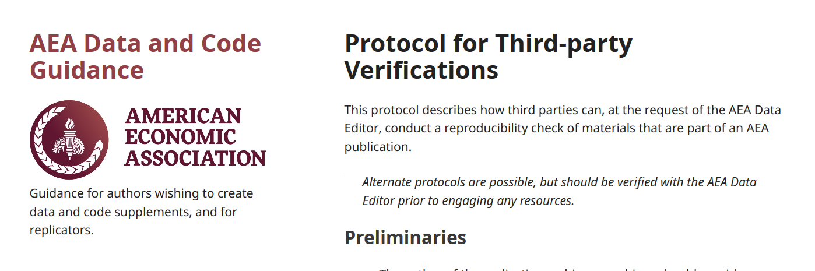
Ad-hoc or peer-to-peer
Journal Data Editor may ask for suggestions of reviewers with access to the same data
Journal Data Editor may ask for permission for reviewers to access the data
Protocol to be followed
Case by case
Effort?

Slide 70
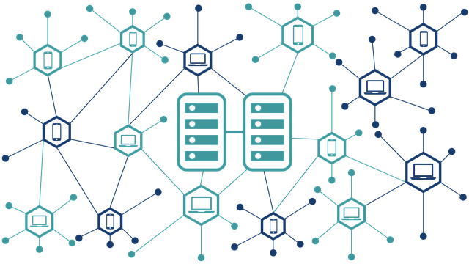
Other options
Cryptographic signatures
Blockchain
All of the previous
Image by VIN JD on Pixabay

Slide 71
This is an unsolved problem.

Slide 72
Challenges
Documentation
How can others learn about the data?
Verifiability
How can others obtain access?
Persistence
How are data and programs preserved?
Persistence
How are data and programs preserved?

Slide 73
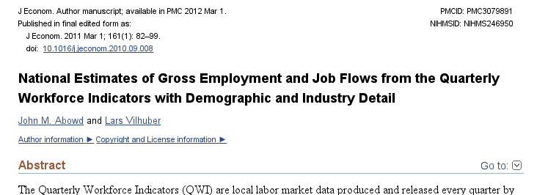
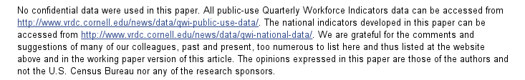
A public-use data solution

Slide 74
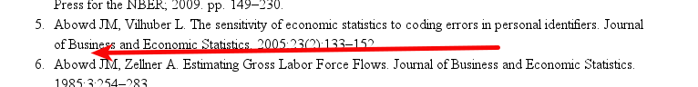
An example: not cited…

Slide 75
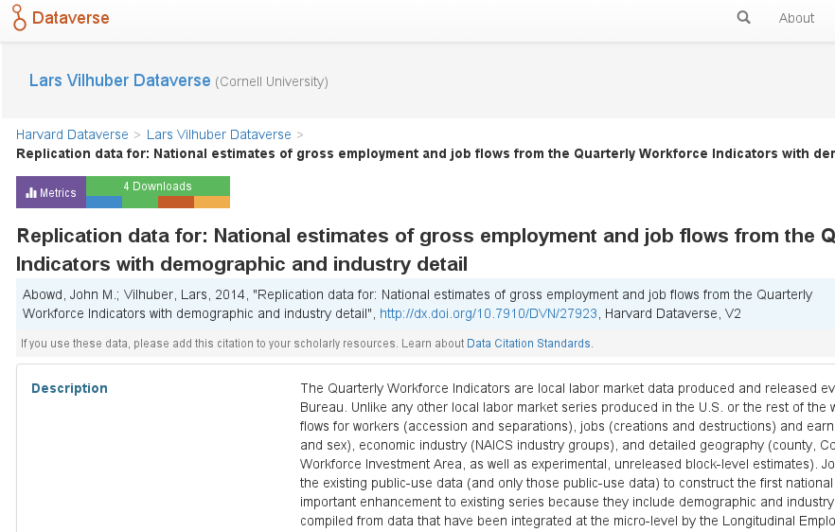
We went back, archived it

Slide 76
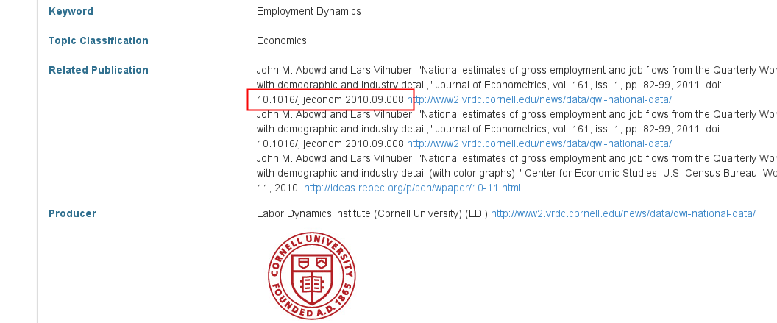
We went back, archived it, linked it back

Slide 77
But: Encourage Best Practices
Deposit and archive early
If you collect data, archive it immediately (possibly privately)
If you finish the manuscript, archive the analysis files (possibly privately)

Slide 78
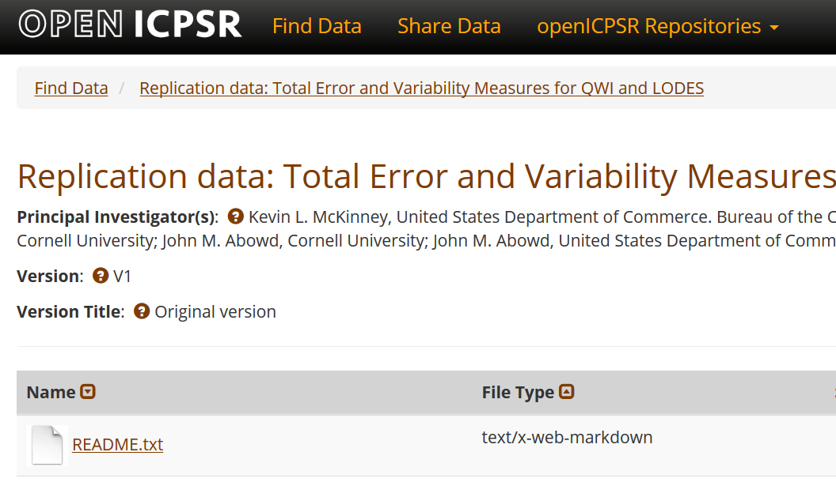
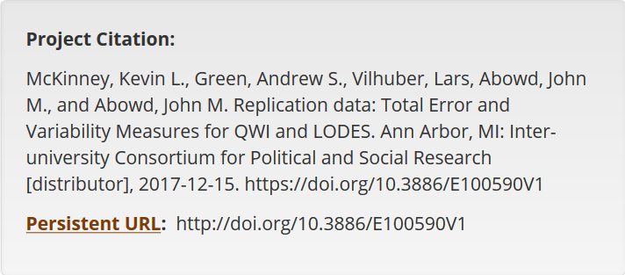
Deposit as soon as you can

Slide 79
This doesn’t work in RDC!

Slide 80
Action: Data citations and metadata
What is FAIR?
Findable,
Accessible,
Interoperable, and
Re-usable

Slide 81
Preserving data in restricted access centers
Use existing procedures
Release as much non-sensitive information to public repositories
Reveal the existence of confidential/sensitive information

Slide 82
Use existing procedures
Version your code (git or svn work without Gitlab or Github!)
Leverage disclosure avoidance procedures
tie “code releases” and “tables” to specific “disclosure avoidance numbers”
Allow (10-year) backup to “archive” files
Make those files findable!
Tie to some DOI or findable tag

Slide 83
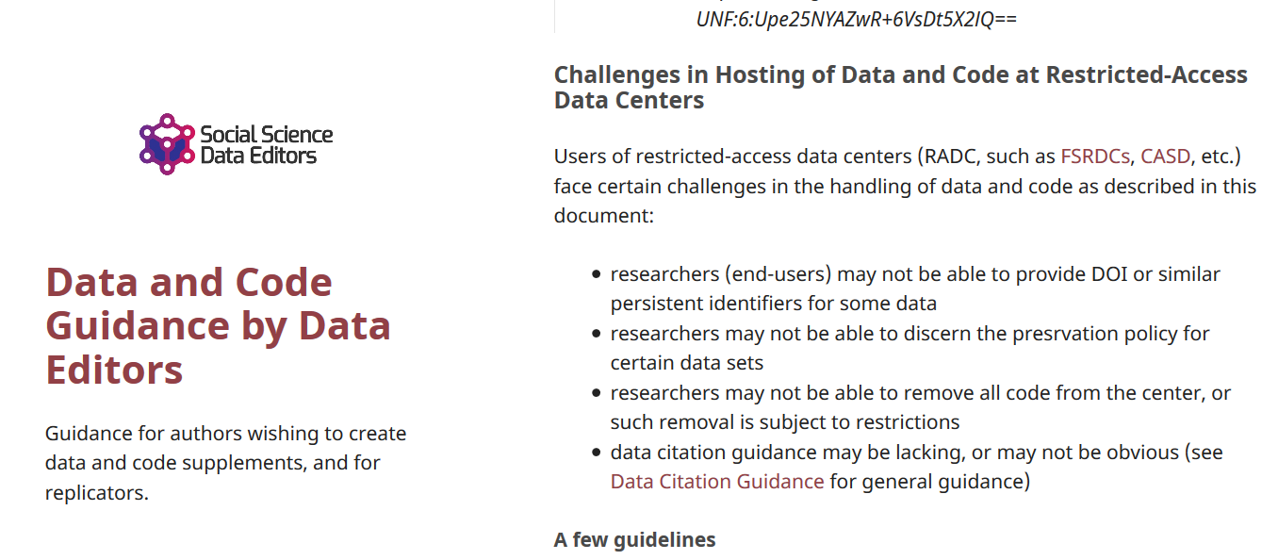
Some guidance
https://social-science-data-editors.github.io/guidance/Requested_information_hosting.html#challenges-in-hosting-of-data-and-code-at-restricted-access-data-centers

Slide 84
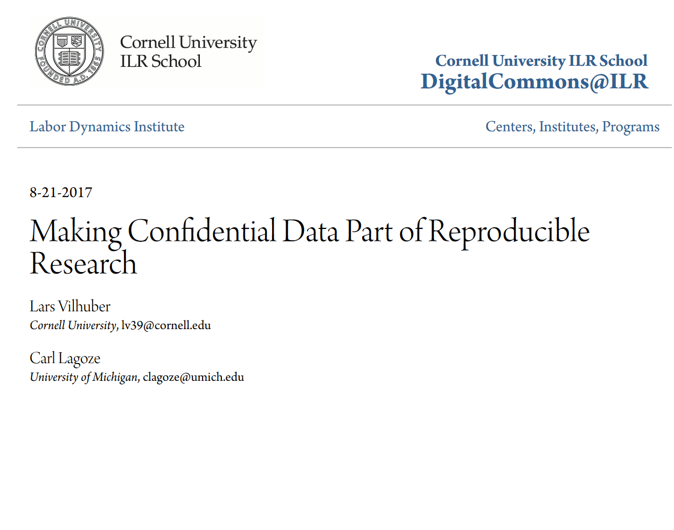
Some more extensive guidance
Making Confidential Data Part of Reproducible Research
Lars Vilhuber, Cornell University Carl Lagoze, University of Michigan
https://digitalcommons.ilr.cornell.edu/ldi/41/

Slide 85
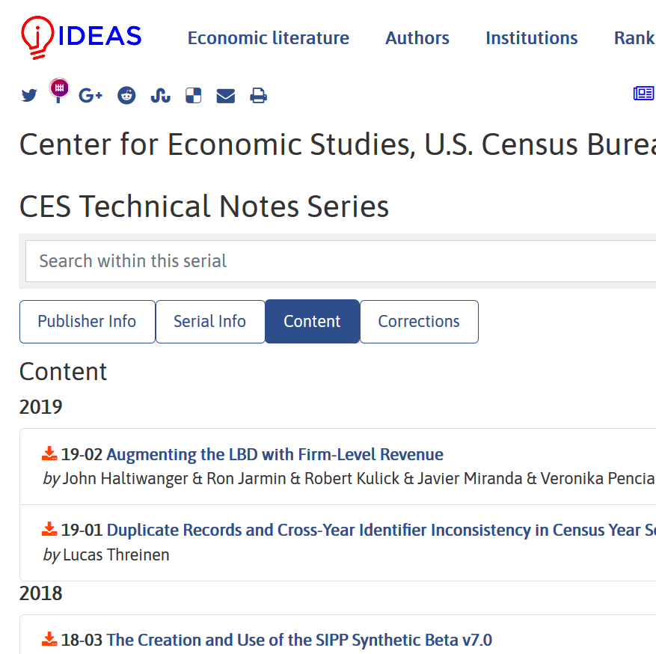
Surfacing additional information
For documents: CES Technical Notes Series
“CES Technical Notes may contain confidential data and, thereby, disclosure is prohibited. Researchers on approved with the correct permissions can request full text notes from (EMAIL)”
Exploring ability to attach data and code archives

Slide 86
Even better: repositories
report’s Recommendation 6-5 encourages NSF to create “code and data repositories for long-term archiving and preservation of digital artifacts that support claims made in the scholarly record.”
These should also be implemented within non-public areas (e.g., FSRDC, etc.)
https://doi.org/10.17226/25303

Slide 87
Evolving Journal and Data Infrastructure
Goal: Use any repository!
(subject to conditions)

Slide 88
Evolving Journal and Data Infrastructure
Treat all archives symmetrically!

Slide 89
Data (and Code) Availability Statements
A statement about where data supporting the results reported in a published article can be found
including unique identifiers linking to publicly archived datasets analyzed or generated during the study.
DASs can increase transparency by providing a reason why data cannot be made (immediately) available
need for registration, ethical or legal restrictions, or because of an embargo period

Slide 91
Challenges?

Slide 92
Some positives

Slide 93
Some random notes
Pre-release verification conducted within the disclosure avoidance mechanism?
Analogy between grant or RDC proposal and pre-registration
Incentives of stats agencies: transparency = credibility
From pre-acceptance verification to pre-submission verification (university or institute services)

Slide 94
Registered Reports
Close cousin: Results-blind review

Slide 95
Registered Reports
Close cousin: RDC access mechanism
CLEAN &
SUBMIT PROPOSAL
Proposal (Peer) Review

Slide 96
Interesting thought
Could the RDC proposal and access mechanism be combined with a registered-report mechanism?

Slide 97
Pre-release verification conducted within the disclosure avoidance mechanism?
RDC users already submit to a hands-off (objective) code execution system (mostly) [qsub / PBS Pro]
Learning curve
Lots of keyboard exercise until it works

Slide 98
Pre-release verification conducted within the disclosure avoidance mechanism?
RDC users already submit to a hands-off (objective) code execution system (mostly) [qsub / PBS Pro]
Could code runs and their output be digitally signed?
… and be automatically submitted to the disclosure avoidance mechanism?

Slide 99
Collaboration

Slide 100
Goal: Transportability
Any standards, tools, methods: must be transportable across journals (no custom solutions)

Slide 101
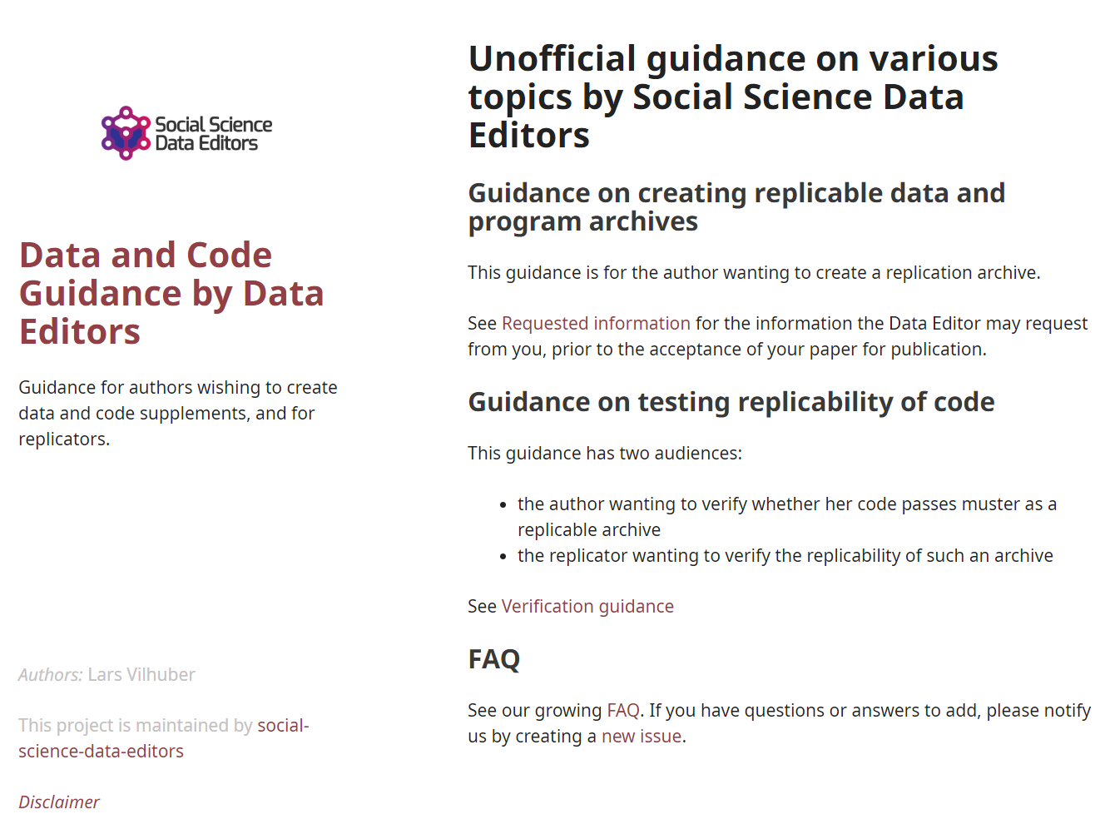
Social science “guild”
https:// social-science -data-editors. github.io/ guidance/

Slide 102
Challenges?

Slide 103
You…

Slide 104
Me…

Slide 105
Change ingrained habits…

Slide 106
New skills to learn…

Slide 107
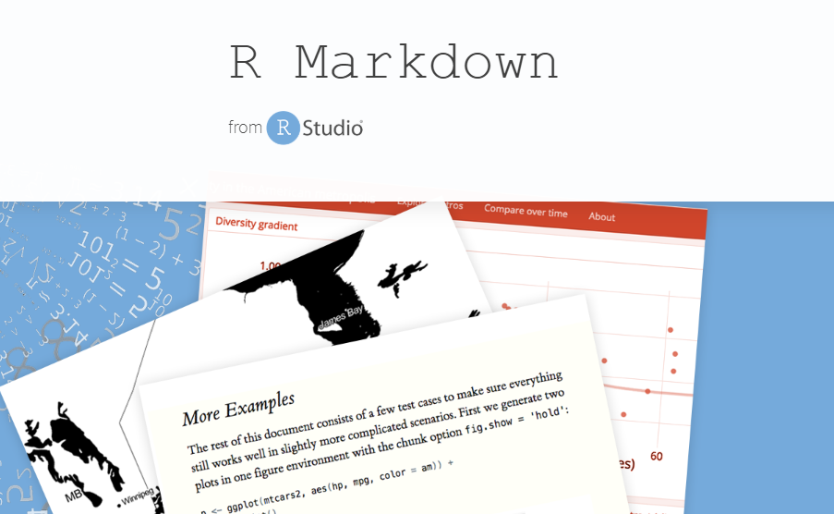
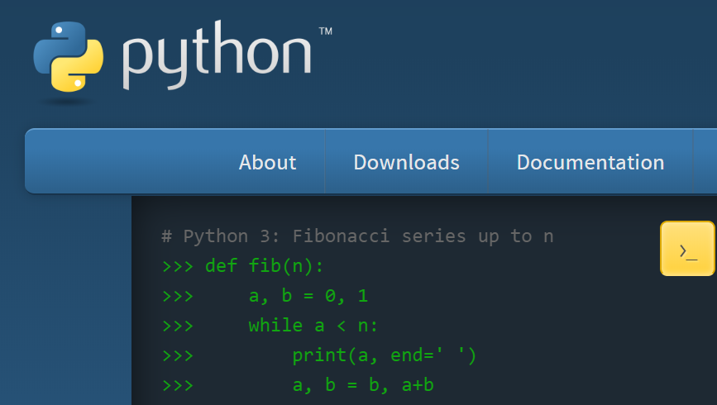

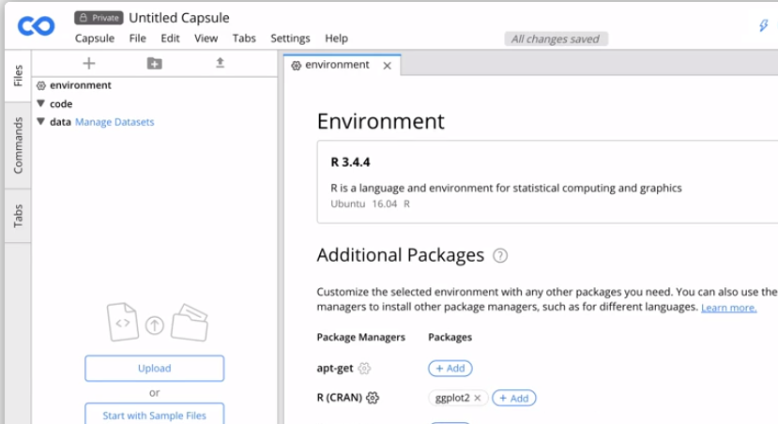

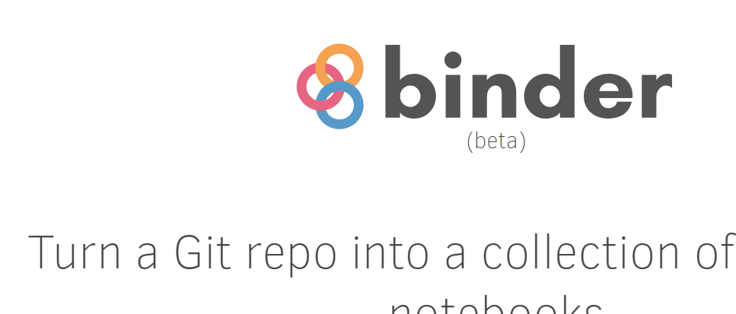

Slide 108
New methods to use …

Slide 109

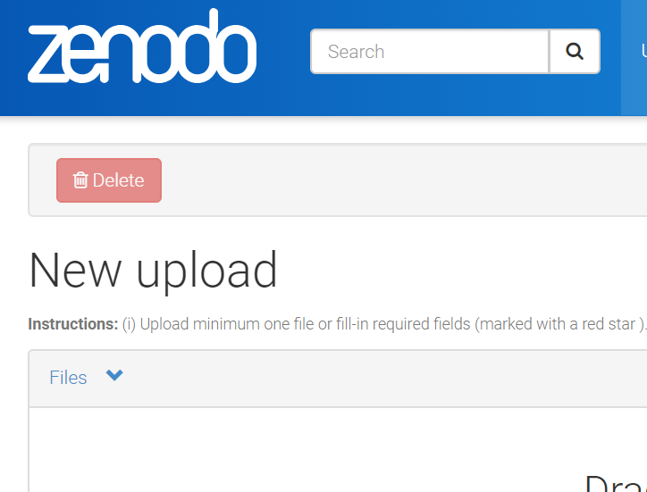
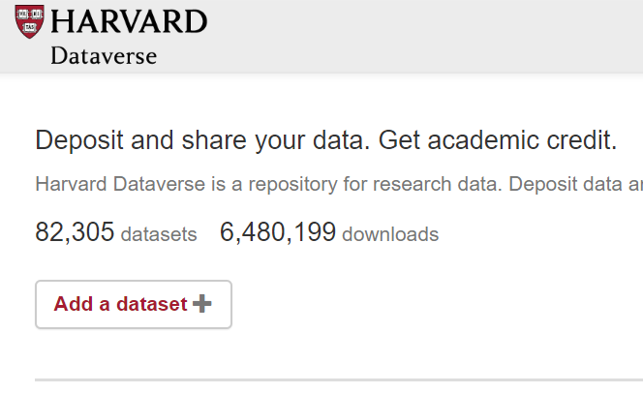
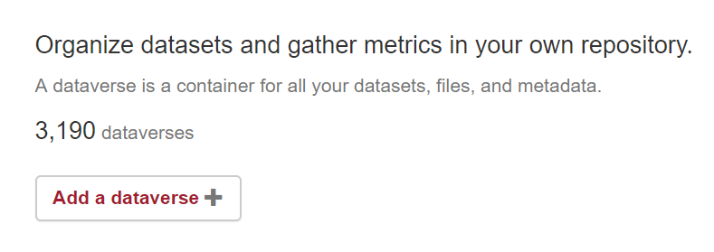
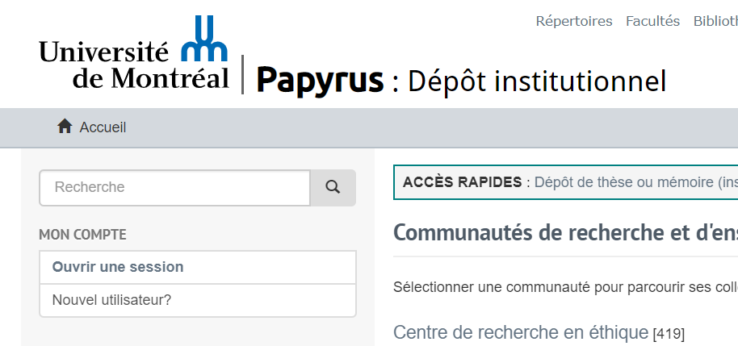
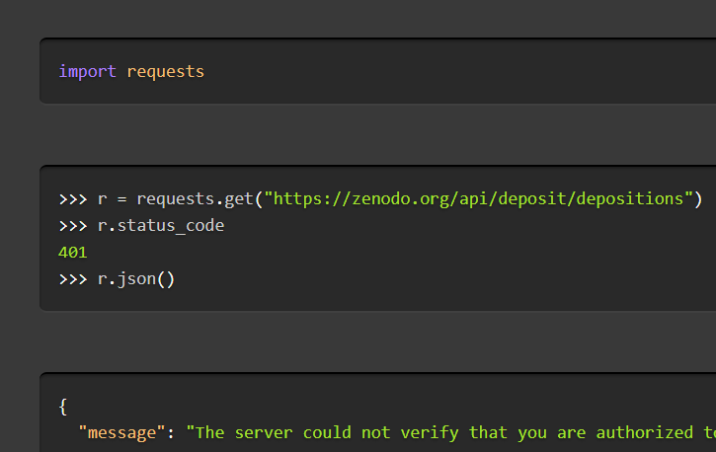

Slide 110
Researchers: New skills to learn/teach
How to incorporate reproducible practices into your workflow
When to pre-register, and when not to
Document early, and often (better READMEs!)
How, where, and when to archive data and code
How to license your contributions!

Slide 111
Summary

Slide 112
Challenges
Documentation
How can others learn about the data?
Verifiability
How can others obtain access?
Persistence
How are data and programs preserved?

Slide 113
Possible solutions
Documentation
Better support, more consistency, new publication tools
Verifiability
Intriguing possibilities, not yet solved
Persistence
Acceptable workarounds, need for robust infrastructure

Slide 114
Thank you!
DOI: 10.5281/zenodo.2573123

